Slide 1
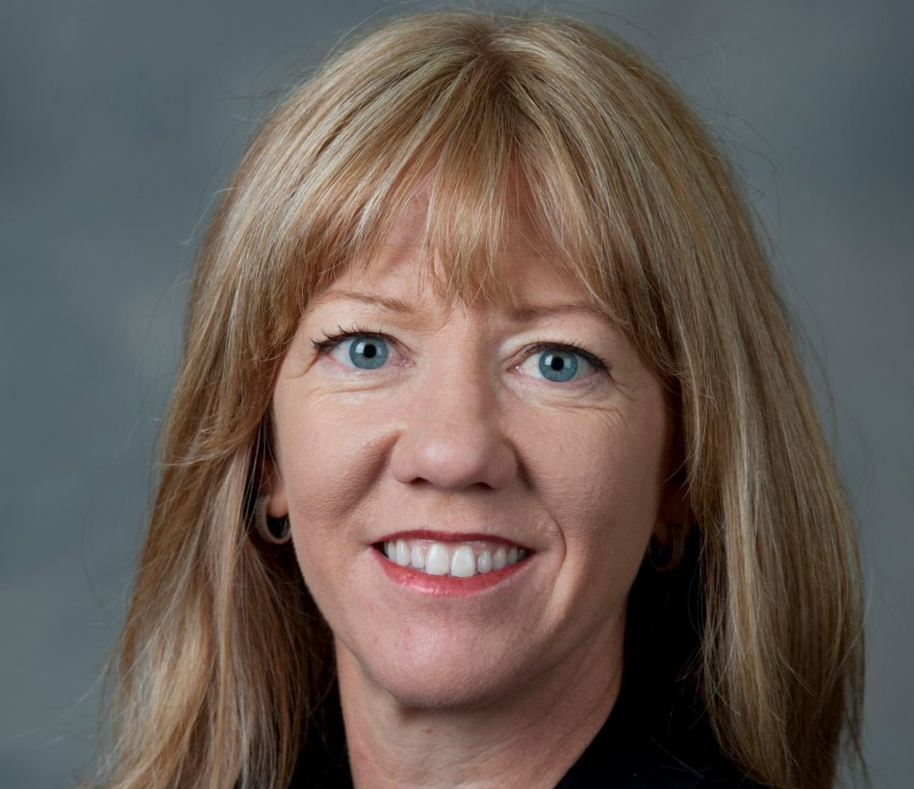
Critical Autoethnography for Scholarship, Pedagogy, and Personal Growth in Teacher Education
F. Blake Tenore and Julie Ellison Justice
School of Teacher Education Colloquium
Florida State University
December 4, 2020

Slide 2
Agenda and Timeline
Scholarly interest in Narrative ways of knowing
Co-editorship of collected scholarly narratives
CAE with authors of scholarly narratives
CAE as pedagogy in preservice Teacher Education
AE as pedagogy in graduate PD w/ teachers
AE as Teacher educator PD?

Slide 3
“To be authentic to the critical process we have to turn [the process] back on ourselves. We have to be real. If I’m going to publicly name systems as problematic, I better be able to name my own contributions to the problem.”
-Mark Davies, contributor to BCTE

Slide 4
Scholarship of
Narrative and Autobiography

Slide 5
What are our stories?
“When somebody tells you his life. . . it is always a cognitive achievement rather than a through-the-clear-crystal recital of something univocally given” (Bruner, 1987, p. 692).
“The story of one's own life is, of course, a privileged but troubled
narrative” (Bruner, 1987, p 693).
“Autobiographical accounts (even the ones we tell ourselves) are notably unstable. On the other hand, this very instability makes life stories highly susceptible to cultural, interpersonal, and linguistic influences” (Bruner, 1987, p. 694)
“There is a landscape of action on which events unfold. . . But there is a
second landscape, a landscape of consciousness, the inner worlds of the protagonists” (Bruner, p. 698).
Bruner, J. (1987) Life as narrative. Social Research, 54(1).

Slide 6
The problem addressed by BCTE
The Contributors
Literature on critical teacher education predominantly addresses preservice teachers’ development and preparation to teach for social justice and equity in diverse learning contexts.
This body of literature does not regularly delve deeply into the teacher educators’ perspectives on and experiences with this work--who are we, why do we do the work of teacher education critically?
20 Teacher educators and researchers
Compose a narrative that stories an event or experience in your life that contributed to your identification as a critical educator. . .reflect on the event through a critical theoretical lens. . . and then describe a teaching practice informed by your experiences.

Slide 7
What is Critical Autoethnography?
Critical autoethnography is a personal cultural analysis developed through personal narrative that allows examination of interpersonal and cultural experiences of identity from the inside out (Hughes, Pennington & Makris, 2012; Boylorn & Orbe, 2014; Hughes & Pennington, 2016).
Scholarly examination of self that positions the researcher as a site of cultural inquiry within a cultural context (Reed-Danahay, 1997)
Autoethnographers use critiques of personal experience against existing research to bring to light aspects of cultural life (Ellis et al., 2010; Ellis et al, 2011)
[A]utoethnography should be ethnographic in its methods. . . cultural in the interpretation. . . and autobiographical in its content. . . [S]elf-reflective writings deficient in any one of these . . . would fall short of ‘auto-ethno-graphy’ (Chang, 2016).

Slide 8
Collaborative Autoethnography
Collaborative Autoethnography (CAE): researchers pooling their narratives to explore them for commonalities and differences and to engage them in relation to their social contexts
(Chang, Ngunjiri, and Hernandez, 2013)
Collaborative Research Question:
What characterizes teacher educators’ development of a critical consciousness and desire to engage in critical teacher preparation?

Slide 9
Collaborative AE Methods
RQ: What characterizes teacher educators’ development of a critical consciousness and desire to engage in critical teacher preparation?
Data Sources:
Participants’ histories, experiences, perspectives, and theories expressed through:
4000-word scholarly narrative memoir
Artifacts: documents, photographs, personal objects
Analytic memos
One-hour semi-structured interview—co-researchers interviewed each other to connect the AE experience—why did we tell this story this way?--and deepen content

Slide 10
Data Analysis
(Chang, Ngunjiri, & Hernandez, 2013)
Phase 1: Initial open coding of each’s own narrative
Phase 2: Analytic memos to describe coding/analysis processes and a statement of relationships among categories of emergent codes
Phase 3: Video conferences to compare codes and discuss discrepancies build consensus thinking about data.
Phase 4: Collaborative axial coding to construct categories of experiences and identify emerging themes in authors’ collective critical becoming.

Slide 11
Findings
Time: as mediator and mediated by authors
Affect: Vulnerability, anger, complicity, care/Love, hope, compassion
Knowledge building: Intentionally, with texts, role models and mentors, graduate school, critical reflection on experiences
Generative relationships: to tell and hear counternarratives; to witness lives with empathy; to build alliances; to recognize our positions in existing power structures; to learn to see societal and institutional structures that marginalize, oppress, and privilege

Slide 12
Autoethnography as Teacher Education Pedagogy

Slide 13
Conceptual Framework for
Teacher Education Pedagogy
Building knowledge
Engaging in generative relationships
Recognizing personal affect
Understanding time as mediated and mediator

Slide 14
CAE as Preservice Teacher Education
Personal narratives focused on identities related to, e.g., race, gender identification, SES, etc.
Created small groups based on sociocultural foci of narratives (e.g., race w/ race; gender ID w/ gender ID)
Shared theoretical and empirical readings (I supplied them to each group)
YA novel related to the topic
Read each others’ narratives
Interviewed each other
Collaborate to analyze and
Reach consensus on findings that speak to what they learned about how ____ operates as a social and cultural mechanism that influences how they understands themselves as teachers and community members

Slide 15
Autoethnography as
Inservice Teacher Education PD
Common readings and examination of narrative and narrative ways of knowing (Bruner, 1987; Gee, 2002; Polkinghorne, 2006; Sfard & Prusak, 2005; Solorzano & Yosso, 2002)
Composed and shared personal, cultural stories in education
Read and analyzed genre features of published educators’ autoethnographies (mentor texts)
Identified socio-cultural centers of gravity that students chose to study using autoethnographic methods (e.g. gender, race)

Slide 16
Narrative Draft Assignment for Teachers
· Focus on one or intersecting aspects of your socio-cultural experiences (e.g. gender, race, sexuality, language background, socio-economic status, nationality, religion, etc.).
· Situated in an education social context. You may write about being a student, teacher, or another position you held in or out of a school working with children or adolescents.
· Include two parts (but the parts may intersect or interrupt each other as you see fit): a story in which you represent yourself in a particular social context and some reflection on the story you tell
· May include craft elements typically associated with narrative or memoir including but not limited to developed characters, dialogue, poetry, manipulations of time, thick description/imagery, figurative language, etc.

Slide 17

AE Data Collection & Analysis
Internal data sources
External data sources
Share. Problematize. Revise. Repeat.
Work in Community: collective reflection, recognition of new understanding, framing, and talk about race, gender, economics, and intersectionalities

Slide 18
Internal Data Sources
Critical Auto-Interviewing
(a) memory recollection: visual flashes of faces, objects, places, interactions, photographs
(b) transcription of those memories into words: thick sensory and emotional descriptions, associations
“In critical auto-interviewing, autoethnographers can use their reconstructed life histories to explore and facilitate insight into their evolving worldviews” (Hughes & Pennington, 2017, p. 65).

Slide 19
Internal Data—Transcribed & Storied Auto-Interview
“The white police officer came to the window and said, “have you been smoking weed? Don’t answer, I can smell it.” My mind raced the roach in my car’s ashtray. “I’ll tell you what,” the officer continued. “If there only a small amount, I’ll let you off with a warning.”
“There’s a roach in the ashtray,” I said. And then I handed the officer the ashtray from my car.
“If this is all there is, I’ll let you go.”
My friend’s and I, all white, were lined up against the wall of subdivision. One officer had us empty our pockets, while the first officer searched the car. There was nothing to be found. Luckily there was nothing to be found. However the point of the story is not about luck. The point of this story is that I handed evidence of a crime to a police officer and I was let off with a warning.”

Slide 20
External Data Sources
Observation: self and others in cultural contexts
Interviews: family, colleagues
Artifacts: documents, photos, objects
Published empirical research
Critical social theory

Slide 21
External Data – Interview with Mom
“In the 70’s, things were just different. Life in a little town seemed to work seamlessly between the blacks and the whites. When we would go shopping, I will never forget how the black kids would be so fascinated by you--your blonde hair and your blue eyes. They couldn’t help but touch your hair. It was harmless, and you didn’t mind. You never met a stranger. There were no issues, except when it came to the schools. The education just wasn’t good. We had talked to some friends of ours who sent their kids to elementary schools there. They complained about their kids talking ‘black.’ And their language was different then. It was much more difficult to understand them. Their way of speaking today has definitely improved” (excerpted from Michelle’s interview with her mother)

Slide 22
Analysis
Problematizing narratives
Open coding and axial coding
Assemblage
Member checking
Non-linear construction
Maintain “self” at the center of the analysis and report

Slide 23
Legitimizing and Problematizing Data (Hughes & Pennington, 2017)
-Is my autoethnography a legitimate representation of critical incidents from my life?
-Is anyone privileged by how I go about legitimizing my autoethnography, and, if so, how?
-Is anyone penalized by how I go about legitimizing my autoethnography, and, if so, how?
-Is my autoethnography linked to specific research traditions, methods, and associations?

Slide 24
From AE to Classroom Inquiry

Slide 25
From AE to Teacher Action Research
Following their AE projects, teachers used what they learned about themselves as guides for developing Research Questions for classroom action research:
What are aspects of my class that marginalize and silence female students?
How does reading about diverse cultures influence students’ feelings of empathy?
How do students experience a literature unit in which whiteness is intentionally decentered?
How do African American students think their reading education is influenced by having an African American male reading teacher?

Slide 26
Thank you!
btenore@fsu.edu

