Slide 1
Presentation Template
Author Name (Department; e.g., EPLS)

Slide 2
Contents
Instructions
  Adding New Slides
Quote Examples
  Centered
  With Picture
By the Numbers Examples
  Multiple Numbers
  With Picture
Icon Callout Example
Design Elements
  Photo Frames
  Linework
  Icons
  Paper Tears

Slide 3
Instructions

Slide 4
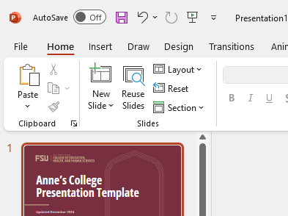
Adding New Slides
To insert a new slide, go to the “Home” Tab and click the drop-down arrow next to “New Slide.” From there, you may select a slide layout from pre-made templates.
These will give you a starting point for your presentation, but you may need to make slight modifications — such as font size and text-box placement — based on the length of your content.

Slide 5
Quote Examples

Slide 6
Education is the most powerful weapon which you can use to change the world.
Nelson Mandela

Slide 7

Education is the most powerful weapon which you can use to change the world.
Nelson Mandela

Slide 8
By the Numbers Examples

Slide 9
$1M+
#3
$66M
Over $1 million in scholarships awarded annually
Ranked best education school in Florida by U.S. News & World Report — #3 nationally among public institutions
$66 million in research expenditures (FY 2023)

Slide 10

4,165
Graduate and undergraduate students

Slide 11
Icon Callout example

Slide 12



World-class Student Resources
Rutrum In
  Adipiscing diam donec adipiscing tristique risus nec feugiat
pellentesque habitant
  Vivamus arcu felis bibendum ut
faucibus in ornare
  Ut aliquam purus sit amet luctus

Slide 13
Design Elements
Create your own slide layouts by copying elements from the following slides.

Slide 14






Photo Frames

Slide 15

Linework
The arch and hex pattern may be cropped and used to subtly accentuate slides.

Slide 16


































































Custom Iconography
Use these custom icons to give a unique flair to your presentation.
For more icons, contact:
brand@fsu.edu
  University Communications
annescollege@fsu.edu
  Anne’s College Office of Strategic Outreach & Recruitment

